Slide 1

Systematic Collection and Analysis of Alternative Splicing Events in Potato Plants
Xiangjia “Jack” Min
Ph. D., Professor
Department of Chemical and Biological Sciences
Youngstown State University, OH 44555, USA
2023 7th International Conference on Biology and Life Sciences (ICBLS2023)

Slide 2
Background
Potato [Solanum tuberosum L] is the third most important food crop, the first most important non-cereal food crop.
The first draft potato genome represented approximately 86% of the 844-megabase genome with 39,031 protein coding genes identified from a homozygous doubled-monoploid potato clone.
The genome sequence super-scaffolds were further assembled into pseudomolecules corresponding to 12 potato chromosomes, representing 674 Mb genome assembly and 37,482 protein coding genes.

Slide 3
What is alternative splicing?
Alternative splicing is a process that two or more RNA isoforms are generated from a single pre-RNA transcript.
It increases the diversity and complexity of transcriptomes and proteomes.
It is estimated >60% of intron-containing genes undergoing alternative splicing in plants.
The process is developmentally regulated and dynamically modulated in responding changing environments.

Slide 4
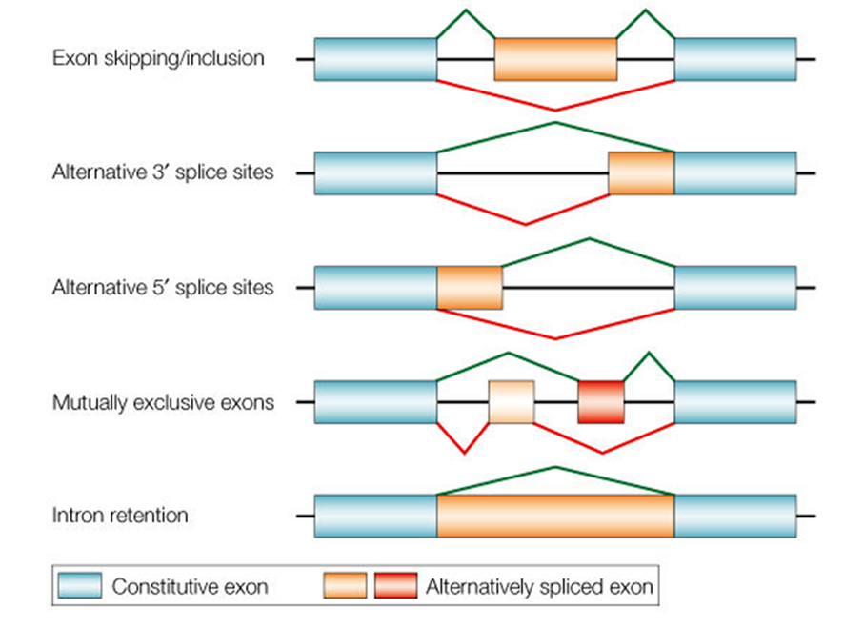
Basic types of alternative splicing events

Slide 5
Objectives
There was a lack of systematic identification and analysis of alternative splicing, including alternatively spliced genes and alternative splicing events, in potato plants.
The objectives of this work are:
Identifying and analyzing alternative splicing events, isoforms and genes in potato plants;
Make the data publicly available to facilitate the information to be used by the community.

Slide 15
Data and Methods
The genome was downloaded from the Phytozome database (https://phytozome-next.jgi.doe.gov/)
EST (Expressed Sequence Tags) and mRNA data were downloaded from the NCBI nucleotide database: A total of 291,071 transcript sequences including 250,140 ESTs and 40,931 mRNA transcripts
RNA-seq data: 227 datasets from 10 recently published projects were downloaded from NCBI SRA database.
85 datasets with single reads
142 datasets with paired reads

Slide 16
Table 1. Potato RNA-seq data sources
Project ID | Dataset | Treatments | References
PRJNA203403 | 36 | Late blight pathogen Phytophthora infestans | Gao et al. (2013) [14]
PRJNA283568 | 19 | Virus Y infection | Goyer et al. (2015) [18]
PRJNA301698 | 30 | Pectobacterium carotovorum ssp. brasiliense infection | Kwenda et al. (2016) [17]
PRJNA311702 | 48 | Drought response of different cultivars | Sprenger et al. (2016) [19]
PRJNA318049 | 36 | Pathogen Phytophthora infestans foliar samples | Gao and Bradeen (2016) [15]
PRJNA476484 | 10 | Drought stress of different cultivars | Moon et al. (2018) [20]
PRJNA565618 | 6 | Nitrogen treatments | Tiwari et al. (2020) [21]
PRJNA529319 | 6 | Nitrogen treatments | Tiwari et al. (2020) [22]
PRJNA544876 | 24 | Biotic stress response induced by light exposure | Zhang et al. (2019) [16]
PRJNA679820 | 12 | Potato virus X infection | Herath and Verchot (2021) [23]

Slide 17
Methods
EST/mRNA: assembled with CAP3, mapped to genome with ASFinder
RNA-seq data: mapped with Tophat and Cufflinks package
Identification of AS events: Astalavista
Functional annotation: ORF-Predictor, BLAST

Slide 18
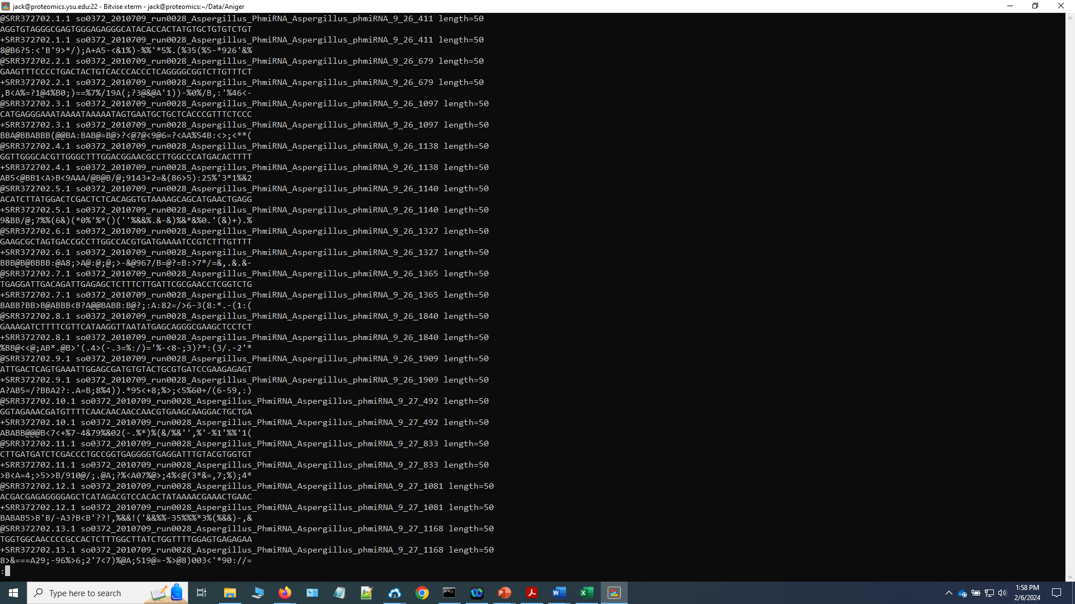

Slide 19
Results
Table 2. Summary of mapping rates of RNA-seq data generated in different projects.
 |  | Total reads | Total mapped | M. A. | Mapping rate (%) | M. A. (%)
PRJNA203403 | paired | 921149968 | 777587186 | 62810721 | 84.4 | 6.8
PRJNA283568 | single | 563198665 | 492413277 | 29519550 | 87.4 | 5.2
PRJNA301698 | paired | 1375032248 | 1098344225 | 41892005 | 79.9 | 3.0
PRJNA311702 | single | 687593470 | 623243410 | 41622626 | 90.6 | 6.1
PRJNA318049 | paired | 1030833894 | 547774342 | 39040236 | 53.1 | 3.8
PRJNA476484 | paired | 612616770 | 485996341 | 23287500 | 79.3 | 3.8
PRJNA529319 | single | 178768280 | 84186669 | 13199193 | 47.1 | 7.4
PRJNA544876 | paired | 975556406 | 668834427 | 29379255 | 68.6 | 3.0
PRJNA565618 | paired | 470382212 | 402720148 | 30622971 | 85.6 | 6.5
PRJNA679820 | single | 906778800 | 607062704 | 27683452 | 66.9 | 3.1
Total |  | 7721910713 | 5788162729 | 339057509 | 75.0 | 4.4
A total of 7.7 billion reads were collected with 5.8 billion reads (~75.0%) mapped to the genome. Among the mapped reads, ~4.4% reads (0.34 billion) were mapped to two or more genomic loci

Slide 20
Results
Table 3. Categories of alternative splicing events identified from different RNA-seq
datasets and EST/mRNA data.
Project | ExonS | AltD | AltA | IntronR | Complex | Total
PRJNA203403 | 1869 | 1578 | 3547 | 1292 | 4022 | 12308
PRJNA283568 | 6066 | 4918 | 11500 | 5693 | 12610 | 40787
PRJNA301698 | 3133 | 3040 | 7227 | 2944 | 8456 | 24800
PRJNA311702 | 6359 | 4606 | 11348 | 4098 | 13171 | 39582
PRJNA318049 | 1563 | 1368 | 3091 | 884 | 3340 | 10246
PRJNA476484 | 4903 | 3276 | 8045 | 2399 | 6459 | 25082
PRJNA529319 | 2092 | 1626 | 3957 | 1129 | 2779 | 11583
PRJNA544876 | 3783 | 3797 | 10167 | 3067 | 9574 | 30388
PRJNA679820 | 11153 | 6521 | 17987 | 5710 | 16872 | 58243
PRJNA565618 | 1959 | 1955 | 4138 | 973 | 2368 | 11393
RNA-seq merged | 26500 | 18042 | 42656 | 20637 | 110584 | 218419
EST/mRNA data | 1653 | 832 | 1617 | 930 | 1274 | 6306
All data merged | 27435 | 18658 | 43573 | 21496 | 115607 | 226769

Slide 21

Table 4. Basic features of assembled RNA transcripts and functional
annotation in potato plants.
Total genomic loci | 70772
Non-AS loci | 46122 (65.2%)
AS-loci | 24650 (34.8%)
New genomic loci | 29446
Total transcripts | 295952
Transcripts match to gene models | 207694 (70.2 %)
Average length of transcripts (bp) | 1565
BLASTX match against Swiss-Prot database | 207302 (70.0%)
Total predicted ORFs | 256945 (86.8%)
Average length of ORFs (aa) | 332
Total Pfam matches of ORFs | 154753 (60.2%)

Slide 22
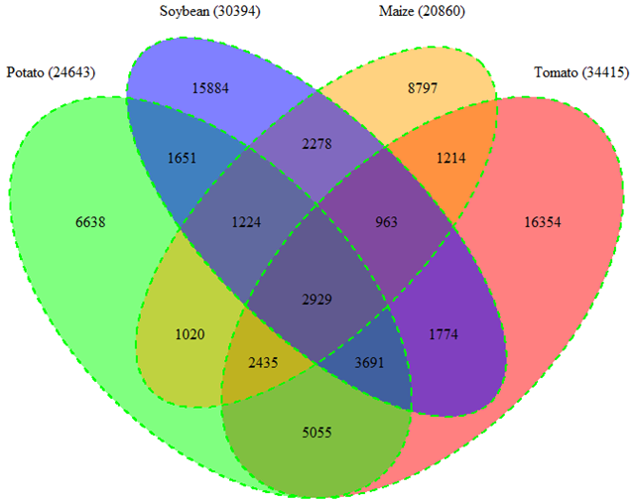
Figure 1. Conserved alternatively spliced genes among potato, tomato, soybean and maize plants.

Slide 23
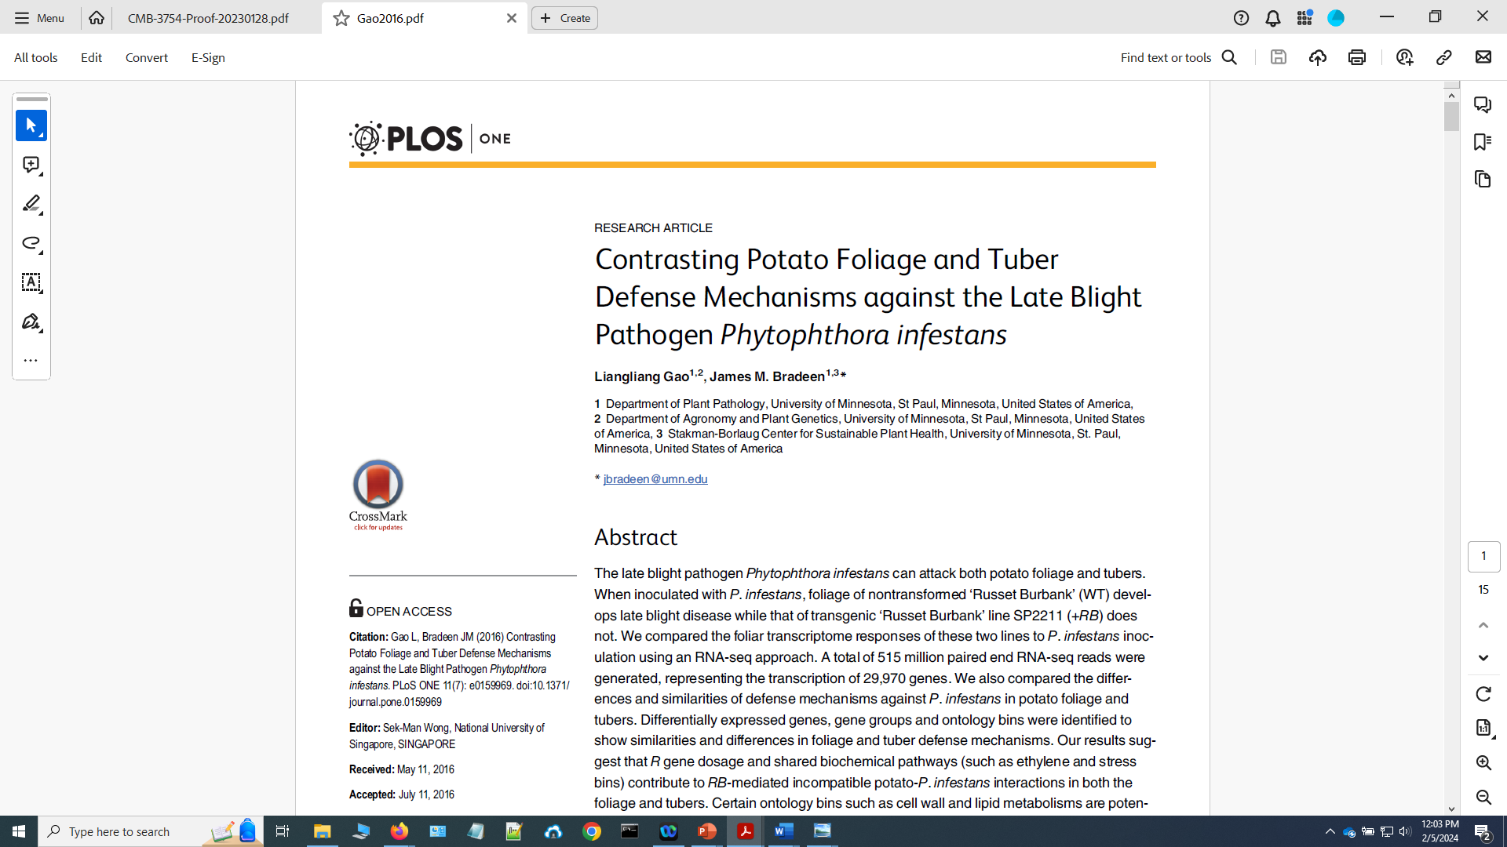

Slide 24
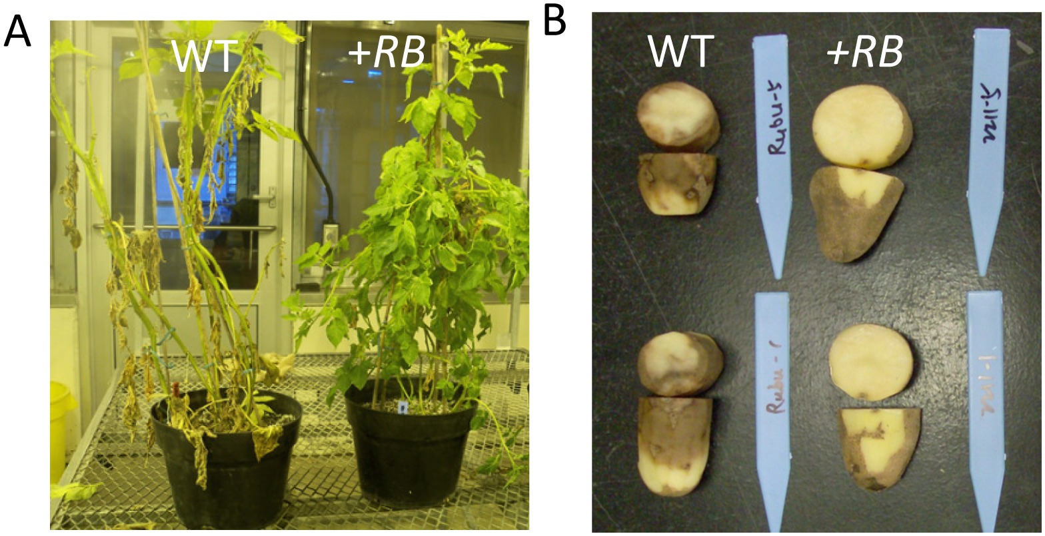
Gao L, Bradeen JM (2016) Contrasting Potato Foliage and Tuber Defense Mechanisms against the Late Blight Pathogen Phytophthora infestans. PLoS ONE 11(7): e0159969. https://doi.org/10.1371/journal.pone.0159969

Slide 26
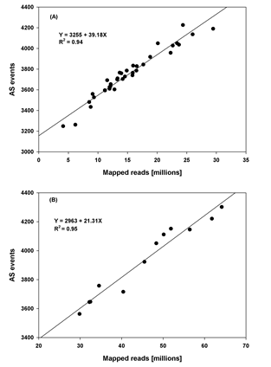
Figure 1 Correlations of mapped reads and the number of alternative splicing events in potato foliar transcriptome samples
Note: (A) data from individual transcriptome samples; (B) data from 12 treatments with bio-replicates merged

Slide 27
Figure 2 Comparison of alternative splicing events of foliar transcriptomes sampled at 24 hours after inoculation with P. infestans and water as controls in wild type and +RB lines of potato plants

Slide 28
Differentially expressed transcripts identified in foliar samples collected at 24 hours post-inoculation with P. infestans or water as controls in two lines of potato plants

Slide 29
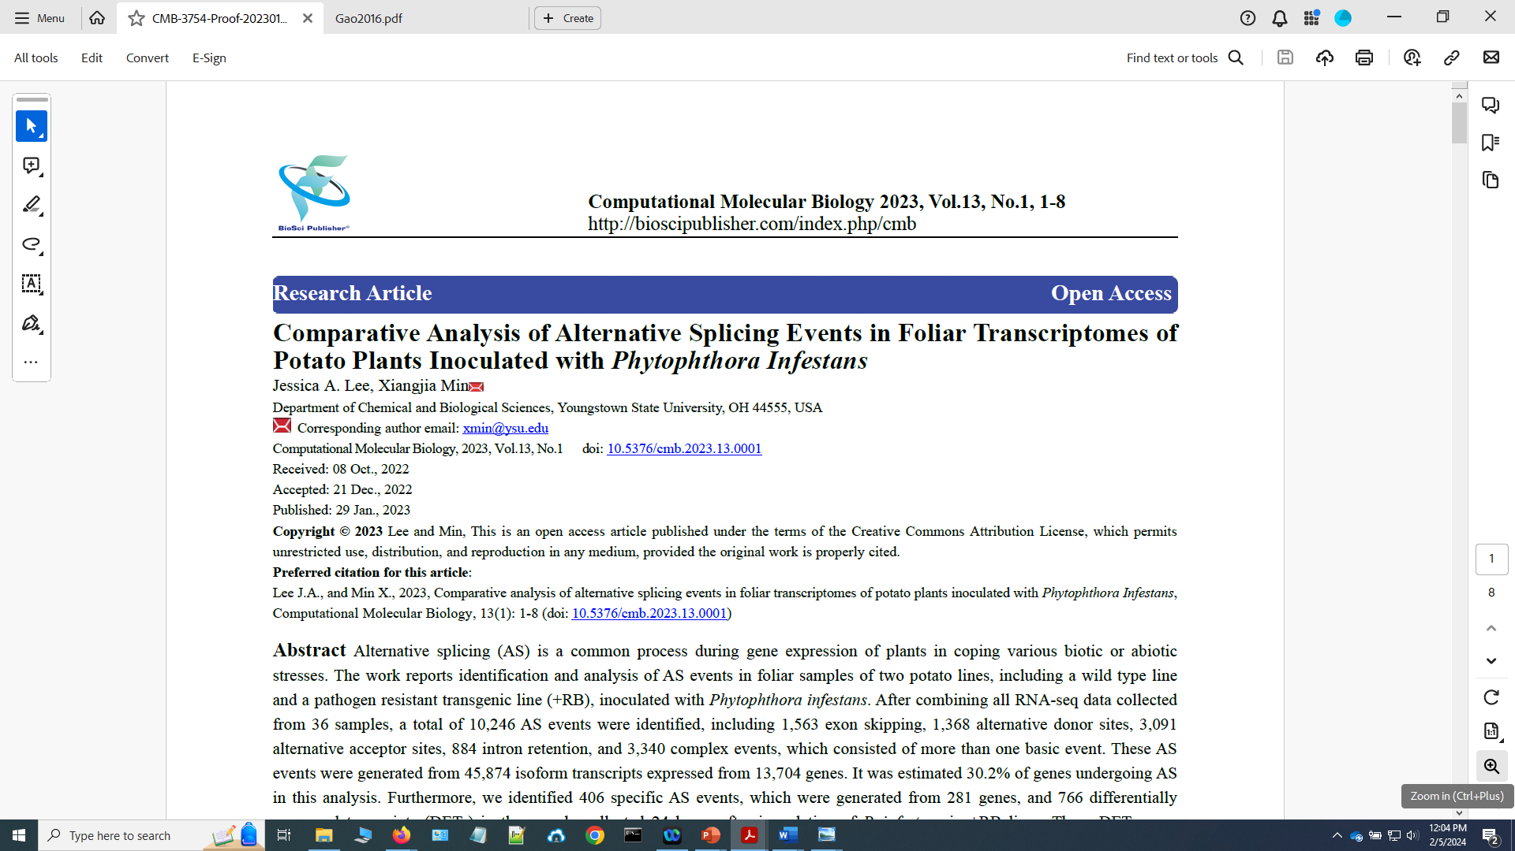

Slide 30
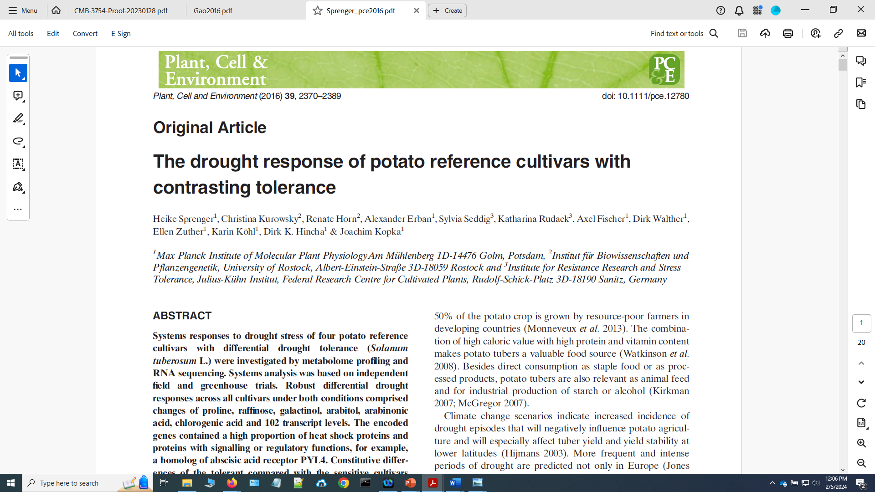

Slide 31
Sprenger et al. (2016)

Slide 32
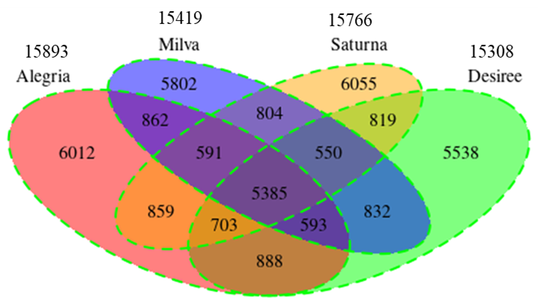
Figure 2. Alternative splicing events identified in four cultivars of potato plants from combined transcriptome data of control and drought treatments.

Slide 33
Table 6. Alternative splicing events in four cultivars of potato plants under control and drought treatments.
 |  | ExonS | AltD | AltA | IntronR | Complex | Total
Cultivar: Alegria
 | Control | 1579 | 1525 | 3497 | 1754 | 2326 | 10681
 | Drought | 1704 | 1576 | 3794 | 1878 | 2369 | 11321
 | Conserved | 879 | 783 | 1801 | 921 | 1166 | 5550
Cultivar: Desiree
 | Control | 1579 | 1494 | 3547 | 1632 | 2259 | 10511
 | Drought | 1706 | 1593 | 3665 | 1847 | 2388 | 11199
 | Conserved | 897 | 761 | 1782 | 897 | 1175 | 5512
Cultivar: Milva
 | Control | 1633 | 1501 | 3411 | 1670 | 2238 | 10453
 | Drought | 1699 | 1513 | 3706 | 1835 | 2448 | 11201
 | Conserved | 908 | 737 | 1776 | 873 | 1203 | 5497
Cultivar: Saturna
 | Control | 1599 | 1531 | 3543 | 1695 | 2278 | 10646
 | Drought | 1718 | 1648 | 3813 | 1957 | 2403 | 11539
 | Conserved | 868 | 756 | 1801 | 914 | 1152 | 5491

Slide 34
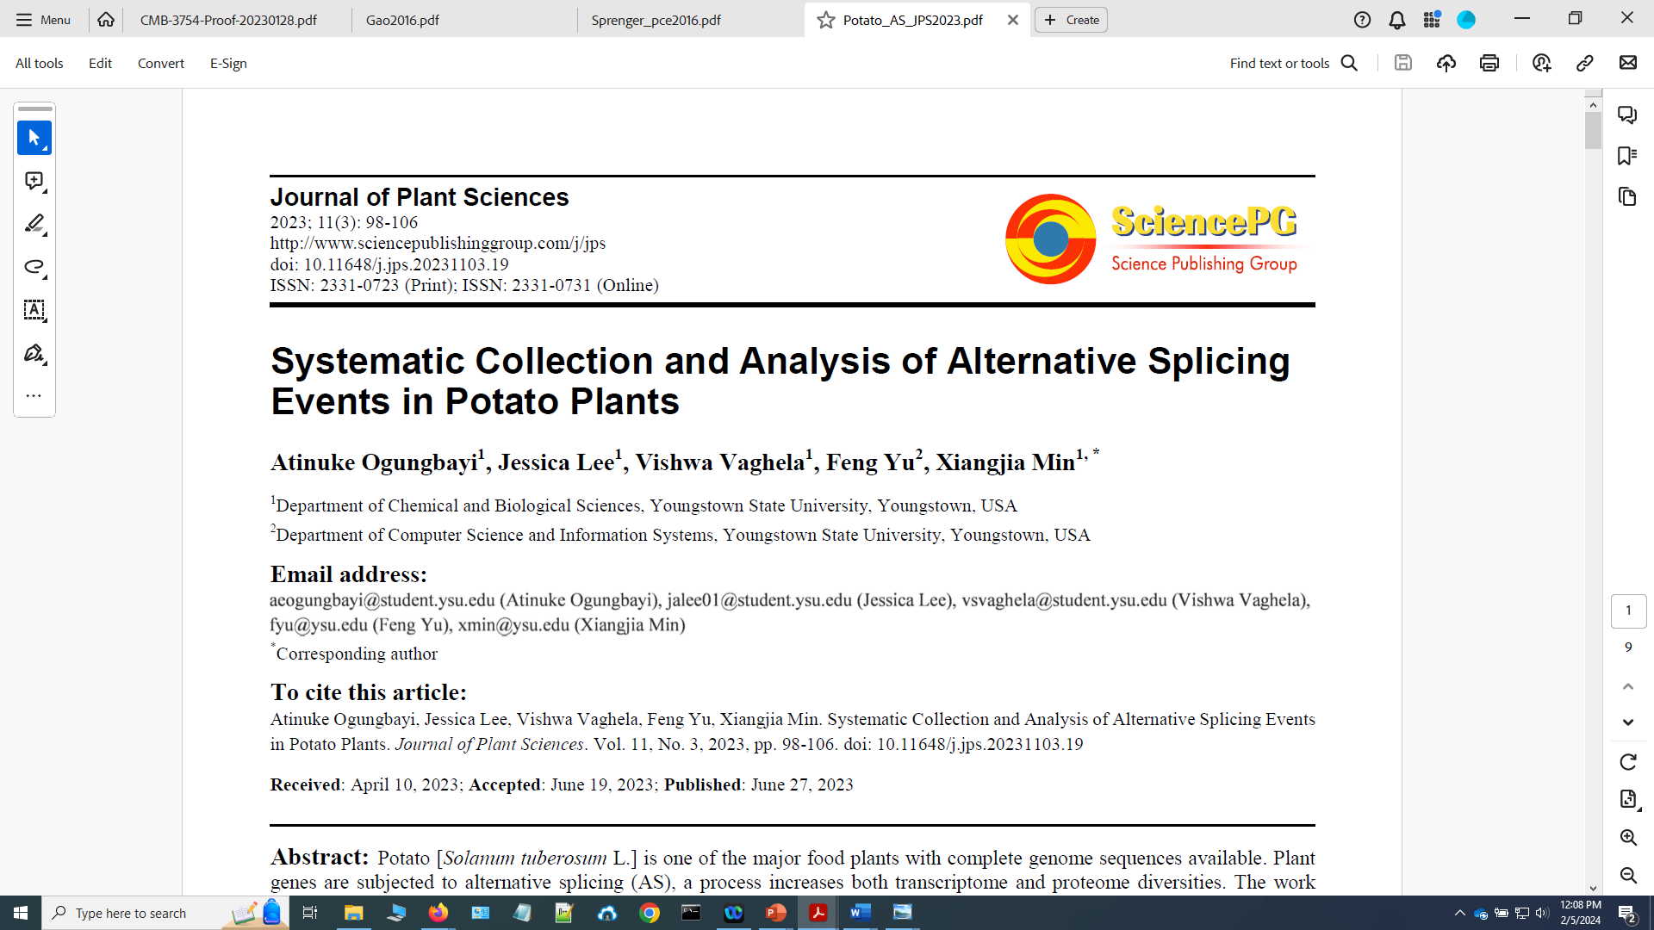

Slide 35
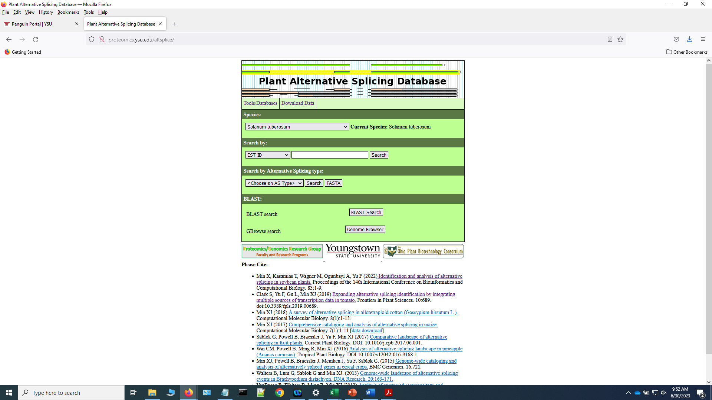

Slide 36
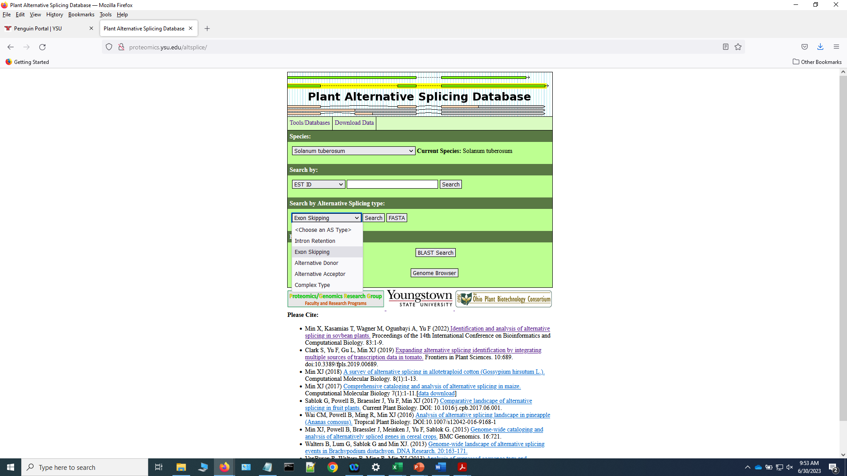

Slide 37
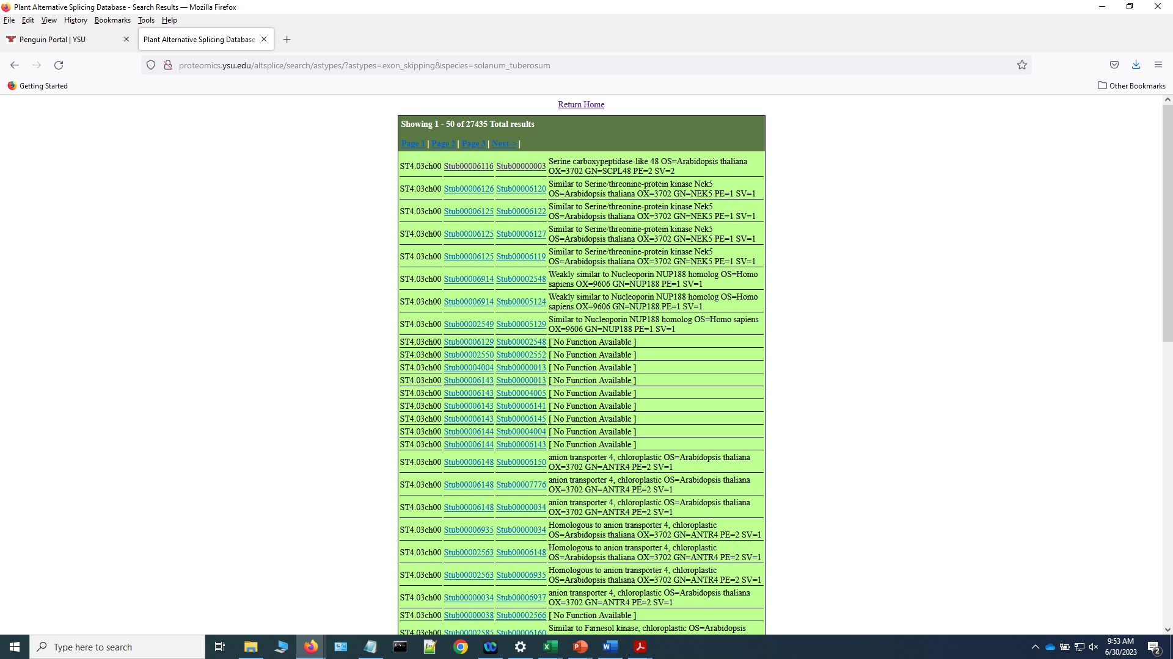

Slide 38
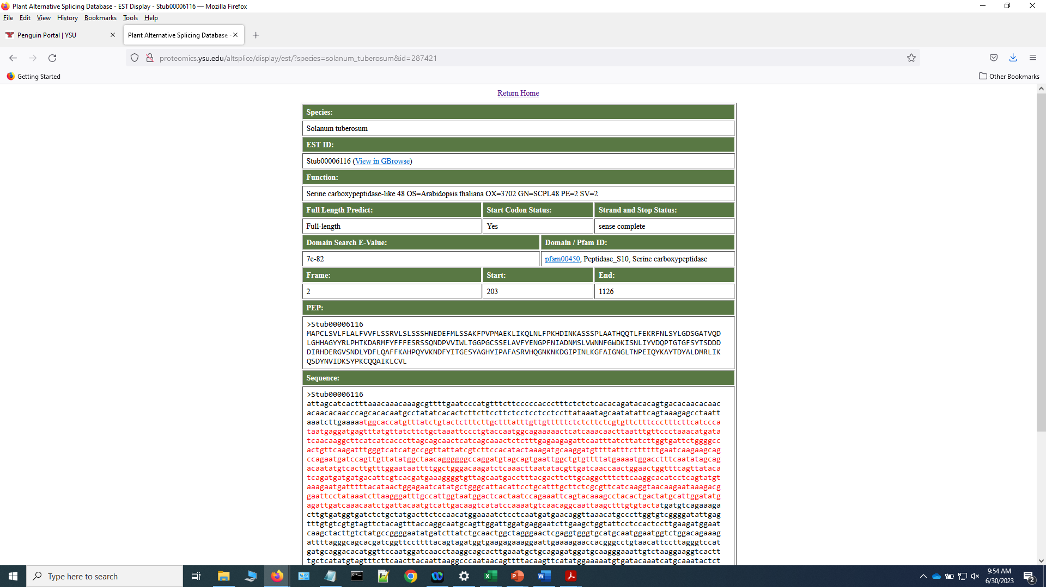

Slide 39
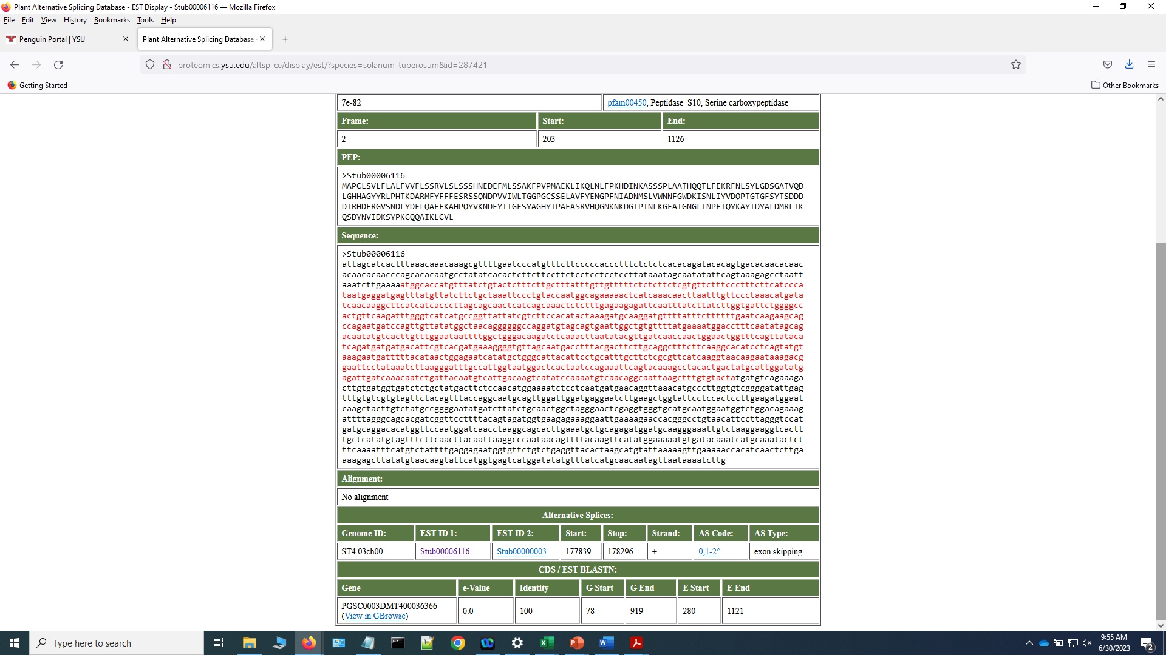

Slide 40
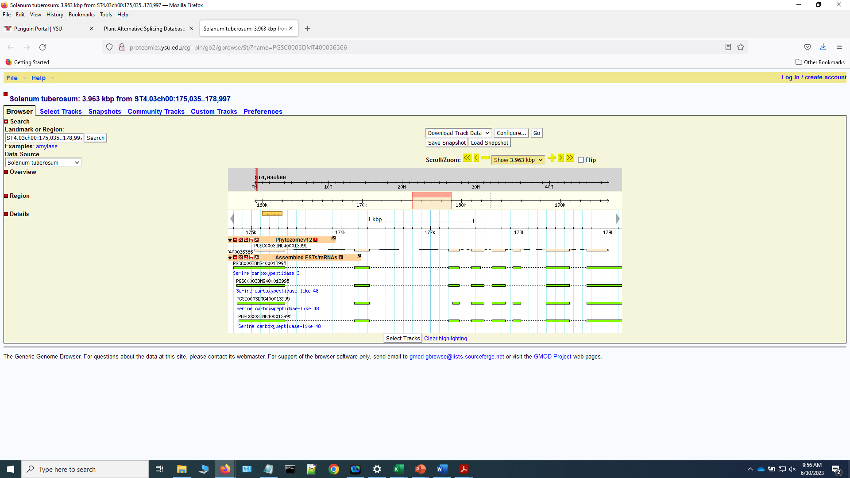

Slide 41
Summary
5.8 billion of RNA-seq reads and >87,000 assembled ESTs/mRNAs were mapped to potato genome and identified a total of 70,772 genomic loci;
A total of 226,769 AS events were identified and categorized into basic events and complex events, which were generated from 24,650 genes.
The AS rate was estimated to be ~34.8% in all expressed genes and 45.8% among annotated gene models;
In addition, a total of 29,446 new genomic loci, which were not previously annotated in the genome, were detected by mapping transcripts to the genome;
The annotated data can be accessed through a public database for searching and downloading. This work provides a resource for further detailed functional analysis of gene products in potato plants.
http://proteomics.ysu.edu/altsplice/

Slide 42
Acknowledgements
Atinuke Ogungbayi Jessica Lee
Vishwa Vaghela Dr. Feng Yu
Youngstown State University Research Professorship
College of Science, Technology, Engineering, and Mathematics (STEM)
The Ohio Supercomputer Center
Department of Chemical and Biological Sciences, YSU
2023 7th International Conference on Biology and Life Sciences (ICBLS2023)

Slide 43
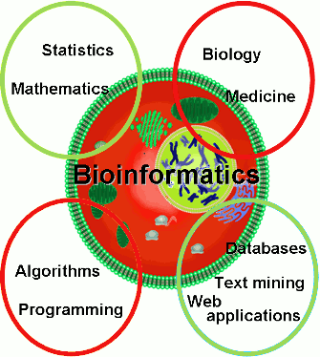

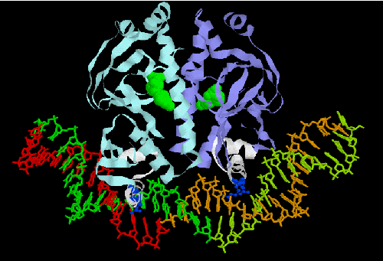
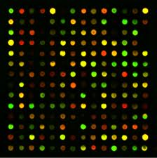
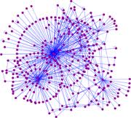
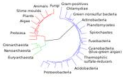
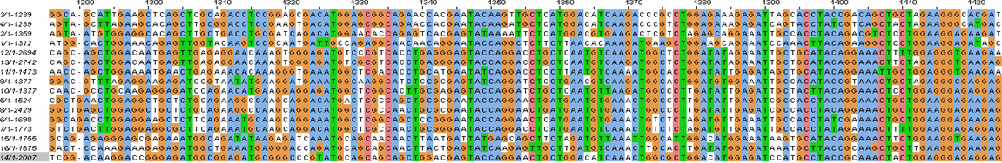
BIOL4800 - Bioinformatics (Spring)
BIOL6900 - Adv. Bioinformatics (Fall)
Using computer to analyze DNA, protein, and genome sequences and systems biology.
Topics:
BLAST and GenBank database
Multiple sequence alignment
Protein structure/function prediction
Phylogenetic analysis
Biological pathways
Gene prediction and genome analysis
Comparative genomics

Slide 44
Bioinformatics
BIOL4800 – Bioinformatics (Spring semester, undergraduate course)
BIOL4850X - Problems Bioinformatics (Undergraduate research)
BIOL6900 - Advanced Bioinformatics (Fall, graduate course)
BIOL5858 – Computational Bioinformatics (Spring, undergraduate and graduate course)

